Slide 1

Spring MVC
With mysql, jpa and Thymeleaf

Slide 2
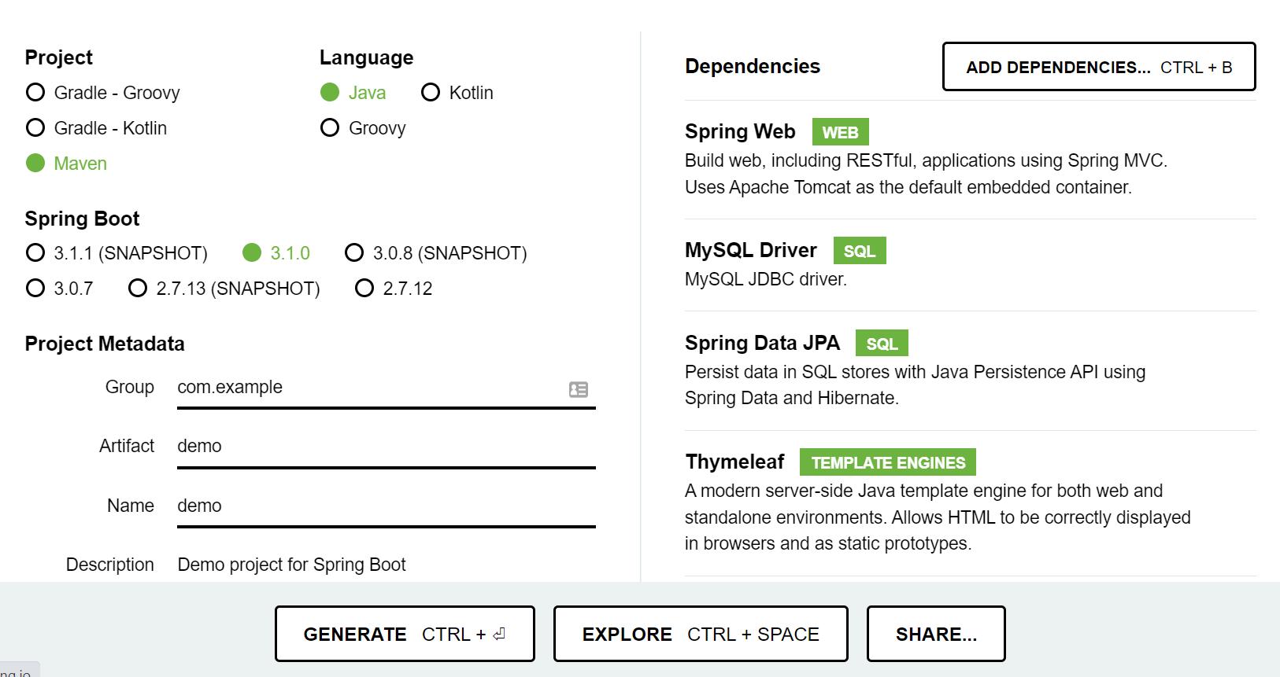
Project Creation
Go to start.spring.io
Create an application with the
following dependencies
Spring Web
MySQL Driver
Spring Data JPA
ThymeLeaf
Lombok

Slide 3
Required dependencies
<dependency>
<groupId>org.springframework.boot</groupId>
<artifactId>spring-boot-starter-web</artifactId>
</dependency>
<dependency>
<groupId>com.mysql</groupId>
<artifactId>mysql-connector-j</artifactId>
<scope>runtime</scope>
</dependency>
<dependency>
<groupId>org.springframework.boot</groupId>
<artifactId>spring-boot-starter-data- jpa</artifactId>
</dependency>
<dependency>
<groupId>org.springframework.boot</groupId>
<artifactId>spring-boot-starter- thymeleaf</artifactId>
</dependency>

Slide 4
Optional dependencies
<dependency>
<groupId>org.projectlombok</groupId>
<artifactId>lombok</artifactId>
<optional>true</optional>
</dependency>
<dependency>
<groupId>org.springframework.boot</groupId>
<artifactId>spring-boot-devtools</artifactId>
<scope>runtime</scope>
<optional>true</optional>
</dependency>

Slide 5
Create a Entity class
@Data
@AllArgsConstructor
@NoArgsConstructor
@Entity
@Table(name="products")
public class Product {
@Id
@GeneratedValue(strategy=GenerationType.IDENTITY)
int id;
String name;
String manufacturer;
String description;
float price;
boolean active;
}

Slide 6
Add configuration details accordingly
application.properties
spring.datasource.url=jdbc:mysql://localhost:3306/dursikshya
spring.datasource.username=root
spring.datasource.password=root
spring.jpa.hibernate.ddl-auto=update
spring.thymeleaf.prefix=classpath:/templates/views/
spring.thymeleaf.suffix=.html

Slide 7
Create Repository Interface
import org.springframework.data.jpa.repository.JpaRepository;
import org.springframework.stereotype.Repository;
@Repository
public interface ProductRepository extends JpaRepository<Product, Integer> {
}

Slide 8
Create a controller class
@Controller
public class ProductController {
@Autowired
ProductRepository productRepo;
}

Slide 9
Add following methods
@GetMapping("/products")
public String products(Model model) {
ArrayList<Product> products = (ArrayList<Product>) productRepo.findAll();
model.addAttribute("products", products);
model.addAttribute("msg","showAll");
return "products";
}
@PostMapping("/products")
public String addProduct(@ModelAttribute("product") Product product) {
productRepo.save(product);
return "redirect:/products";
}

Slide 10
And these methods
@PostMapping("/products/update")
public String updateProduct(@ModelAttribute("product") Product product) {
productRepo.save(product);
return "redirect:/products";
}
@GetMapping("/products/update/{id}")
public String updateProduct(@PathVariable("id") int id, Model model) {
String msg="update";
model.addAttribute("msg", msg);
Product pd = productRepo.findById(id).get();
model.addAttribute("product", pd);
return "products";
}

Slide 11
And these methods
@GetMapping("/products/delete/{id}")
public String deleteProduct(@PathVariable("id") int id, Model model) {
Product pd = productRepo.findById(id).get();
productRepo.delete(pd);
return "redirect:/products";
}
@GetMapping("/products/add")
public String addProduct(Model model) {
String msg="add";
model.addAttribute("msg", msg);
return "products";
}

Slide 12
Create view
products.html
<!DOCTYPE html>
<html xmlns:th=http://www.thymeleaf.org>
<head>
<title>Ecommerce Content Management</title>
<link rel="stylesheet" href="https://cdn.jsdelivr.net/npm/bootstrap@4.0.0/dist/css/bootstrap.min.css" integrity="sha384-Gn5384xqQ1aoWXA+058RXPxPg6fy4IWvTNh0E263XmFcJlSAwiGgFAW/dAiS6JXm" crossorigin="anonymous“>
</head>
<body>
<h1>Products</h1>
</body>
</html>

Slide 13
Create view
products.html
<!DOCTYPE html>
<html xmlns:th=http://www.thymeleaf.org>
<head>
<title>Ecommerce Content Management</title>
<link rel="stylesheet" href="https://cdn.jsdelivr.net/npm/bootstrap@4.0.0/dist/css/bootstrap.min.css" integrity="sha384-Gn5384xqQ1aoWXA+058RXPxPg6fy4IWvTNh0E263XmFcJlSAwiGgFAW/dAiS6JXm" crossorigin="anonymous“>
</head>
<body>
<h1>Products</h1>
</body>
</html>

Slide 14
Add the table in it…
<div id="product-table " class="col-8 m-auto" th:if="${msg=='showAll'}">
<h1>All Products</h1>
<span><a th:href="@{/products/add}"><button class="btn btn-primary btn-small float-right m-1">add a product</button></a></span>
<table class="table table-striped ">
<tr>
<th scope="col">Name</th>
<th scope="col">Manufacturer</th>
<th scope="col">Description</th>
<th scope="col">Price</th>
<th scope="col">Active</th>
<th scope="col">Action</th>
</tr>
<tr th:each="product: ${products}">
<td th:text="${product.getName()}"></td>
<td th:text="${product.manufacturer}"></td>
<td th:text="${product.description}"></td>
<td th:text="${product.price}"></td>
<td th:text="${product.active}"></td>
<td>
<a th:href="@{'/products/update/'+${product.id}}"><button class="btn btn-primary btn-small">Edit</button></a>
<a th:href="@{'/products/delete/'+${product.id}}"><button class="btn btn-primary btn-small">Delete</button></a>
</td>
</tr>
</table>
</div>

Slide 15
Add new product form
<div class="product-form col-8 m-auto" th:if="${msg=='add'}">
<h1>Product Form</h1>
<form action="/products" name="product" method="post">
<div class="form-group">
<label for="productName">Product Name: </label>
<input type="text" class="form-control" name="name" id="productName" placeholder="Name">
</div>
<div class="form-group">
<label for="productManufacturer">Manufacturer: </label>
<input type="text" class="form-control" name="manufacturer" id="productManufacturer" placeholder="Manufacturer">
</div>
<div class="form-group">
<label for="productDescription">Description: </label>
<textarea type="text-area" class="form-control" name="description" id="productDescription" placeholder="Products Description" rows="3"></textarea>
</div>
<div class="form-group">
<label for="productPrice">Price: </label>
<input type="number" class="form-control" name="price" id="productPrice" placeholder="Products Price">
</div>
<div class="form-check">
<input class="form-check-input" type="radio" name="active" id="isActive" value="true" checked>
<label class="form-check-label" for="isActive">Active</label>
</div>
<div class="form-check">
<input class="form-check-input" type="radio" name="active" id="isNotActive" value="false">
<label class="form-check-label" for="isNotActive">Inactive</label>
</div>
<button type="submit" class="btn btn-primary">Submit</button>
</form>
</div>

Slide 16
Add update product form
<div class="product-form col-8 m-auto" th:if="${msg=='update'}">
<h1>Product Update Form</h1>
<form action="/products/update" name="product" method="post">
<input type="hidden" name="id" th:value="${product.id}">
<div class="form-group">
<label for="productName">Product Name: </label>
<input type="text" class="form-control" name="name" id="productName" th:value="${product.name}">
</div>
<div class="form-group">
<label for="productManufacturer">Manufacturer: </label>
<input type="text" class="form-control" name="manufacturer" id="productManufacturer" th:value="${product.manufacturer}">
</div>
<div class="form-group">
<label for="productDescription">Description: </label>
<textarea type="text-area" class="form-control" name="description" id="productDescription" th:text="${product.description}" rows="3"></textarea>
</div>
<div class="form-group">
<label for="productPrice">Price: </label>
<input type="number" class="form-control" name="price" id="productPrice" th:value="${product.price}">
</div>
<div class="form-check">
<input class="form-check-input" type="radio" name="active" id="isActive" value="true" th:checked="${product.active}">
<label class="form-check-label" for="isActive">Active</label>
</div>
<div class="form-check">
<input class="form-check-input" type="radio" name="active" id="isNotActive" value="false" th:checked="${!product.active}">
<label class="form-check-label" for="isNotActive">Inactive</label>
</div>
<button type="submit" class="btn btn-primary">Submit</button>
</form>
</div>

Slide 17
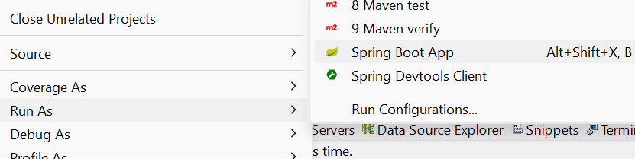
Run the application

Slide 18

Any Questions?

Slide 19
Thank You!

